Slide 1

Yr. 6 Sats 2026
Presentation for Parents and Carers
Thursday 27th November

Slide 2

What are the SATS tests?
The end of KS2 assessments are sometimes informally referred to as ‘SATS’.
SATS week across the country begins on 11th May 2026
Pupils will complete test papers in some of1the areas that have to be assessed. Other areas, like writing, are assessed using evidence collected by the teacher over a longer period of time.
Pupils will complete SATS test papers in:
- Reading
- Grammar, Punctuation & Vocabulary
- Spelling
- Arithmetic
- Mathematical Reasoning – 2 papers

Slide 3

How do the tests take place?
The tests all take place in normal school time, under test conditions.
Pupils will not be allowed to talk to each other during the tests.
The completed papers are sent away to be marked externally.
Results are returned to school in July.
The tests vary in length but last no longer than 60 minutes:
- Reading: 60 minutes
- Grammar, Punctuation & Vocabulary: 45 minutes
- Spelling: 15 minutes
- Arithmetic: 30 minutes
- Mathematical Reasoning: 2 papers of 40 minutes each.

Slide 4
SATS DATES
Dates | Sats Paper | Length of time
Monday 11th May | Grammar paper 1 Spelling | 45 minutes 15 minutes
Tuesday 12th May | Reading | 60 minutes
Wednesday 13th May | Arithmetic paper Reasoning paper 1 | 30 minutes 40 minutes
Thursday 14th May | Reasoning paper 2 | 40 minutes

Slide 5

How are the tests graded?
The marked tests will provide the following information:
- A raw score (i.e. number of marks)
- A scaled score (see below)
- An indication of whether the national standard has been met.
In scaled scores, a score of 100 represents the national standard. The lowest is 80 and the highest is 120.
After each test is marked, it will be converted into a scaled score and that will show whether a pupil is working at the national standard, or above or below it.
A pupil will need to achieve a scaled score of 100 to show that they have met the national standard on the test.
Higher attaining pupils should expect a scaled score of above 110 to 120 which would indicate the pupil is working above the expected standard.

Slide 6
Support in SATS
Some children, if they meet the requirement will be able to have extra support. This could consist of:
Extra time – up to 25% of the time given
Reader
Scribe
Rest breaks
Test modified e.g. printed on different coloured paper.
Prompts
You will be informed if this affects your child.

Slide 7

Grammar, Punctuation and Spelling: Monday 11th May
Grammar, punctuation and spelling consists of two papers.
Paper 1 focuses on all three elements (grammar, punctuation and spelling or GPS). The paper lasts for 45 minutes.
Paper 2 consists of a spelling test only. It should take approximately 15 minutes, although this is not a set amount of time (pupils should be given as much time as they need to complete the test).

Slide 8

Grammar, Punctuation and Spelling: Paper 1 (GPS)
The children will have been working hard with their class teacher on developing and securing their knowledge of the technical vocabulary needed in this test.
This test focuses on:
Grammatical terms/ word classes;
Functions of sentences;
Combining words, phrases and clauses;
Verb forms, tenses and consistency;
Punctuation;
Vocabulary;
Standard English and formality.
This test requires a range of answer types but does not require longer formal answers.
Notes:
The question types include:
Circling
Drawing lines to connect
Multiple choice questions (including ticking tables)
One-word answers
Short answer questions

Slide 9



Grammar, Punctuation and Spelling: Paper 1 (GPS)
Example questions:
✔
The council maintain the local park.
Notes:
Questions are from the 2025 GPS SATs paper.
For question 43 the answer scheme details 2 correct answers and answers that should not be accepted (e.g. misspellings of verb forms or errors in punctuation or capitalisation.)

Slide 10


Grammar, Punctuation and Spelling: Paper 2 (spelling)
Paper 2 is a shorter paper that focuses solely on spellings.
Example questions:
Notes:
Questions are from the 2025 Spelling SATs paper.

Slide 11

Reading: Tuesday 12th May
There is one reading test that lasts for 60 minutes.
The test is designed to measure if the children’s comprehension of age-appropriate reading material meets the national standard. There are three different set texts for children to read. These could be any combination of non-fiction, fiction and/ or poetry.
The test covers the following areas (known as Content Domains):
Give/ explain the meaning of words in context;
Retrieve and record information/ identify key details from fiction and non-fiction;
Summarise main ideas from more than one paragraph;
Make inferences from the text/ explain and justify inferences with evidence from the text;
Predict what might happen from details stated and implied;
Identify/ explain how information/ narrative content is related and contributes to meaning as a whole;
Identify/ explain how meaning is enhanced through choice of words and phrases;
Make comparisons within the text.

Slide 12



Reading
The reading SATs paper requires a range of answer styles.
Example questions:
Notes:
Questions are from the 2025 Reading SATs paper.
Question styles include:
Multiple choice questions
One-word answers
Short answer questions
Multiple mark (long answer) questions

Slide 13




Reading
Example questions:
Notes:
Questions are from the 2025 Reading SATs paper.

Slide 14



Reading
Example questions:
3 mark question
Notes:
Questions are from the 2025 Reading SATs paper.

Slide 15
Reading
Since the current testing formation for the SATs began in 2016, there has been a tendency for three types of questions to be the most popular.
In the 2025 Reading SATs paper,
12% of marks could be gained from answering questions involving giving and explaining the meaning of words in context;
30% of marks could be gained from answering questions involving retrieving and recording information or identifying key details from a text;
48% of marks could be gained from answering questions involving making inferences from a text and justifying inferences with text evidence.
When reading with your child at home try focusing on these types of questions.
Notes:
6% of questions: summarising main ideas from more than one paragraph.
2% of questions: making comparisons within the text
2% of questions: Identify and / or explain how meaning is enhanced through choice of words and phrases.
Example questions to ask at home:
What does this word mean?
Which word in this paragraph is the closest in meaning to…?
What [character] doing when [event] happened?
True or false questions about a paragraph/ text.
Why do you [character] did [event]? Can you think of another reason?

Slide 16
Maths: Wednesday 13th May and Thursday 14th May
The maths assessments consist of three tests.
Paper 1: Arithmetic (30 minutes) – Wednesday 13th May
Paper 2: Reasoning (40 minutes) – Wednesday 13th May
Paper 3: Reasoning (40 minutes) – Thursday 14th May

Slide 17


Maths Paper 1 (Arithmetic)
The maths arithmetic paper has a total of 40 marks and lasts for 30 minutes.
The test covers the four operations (addition, subtraction, multiplication, division, including order of operations requiring BIDMAS), percentages of amounts and calculating with decimals and fractions.
Example questions:
Notes:
Questions are from the 2025 Arithmetic SATs paper.
Identify that there are some questions that have 2 marks and some that have 1.

Slide 18

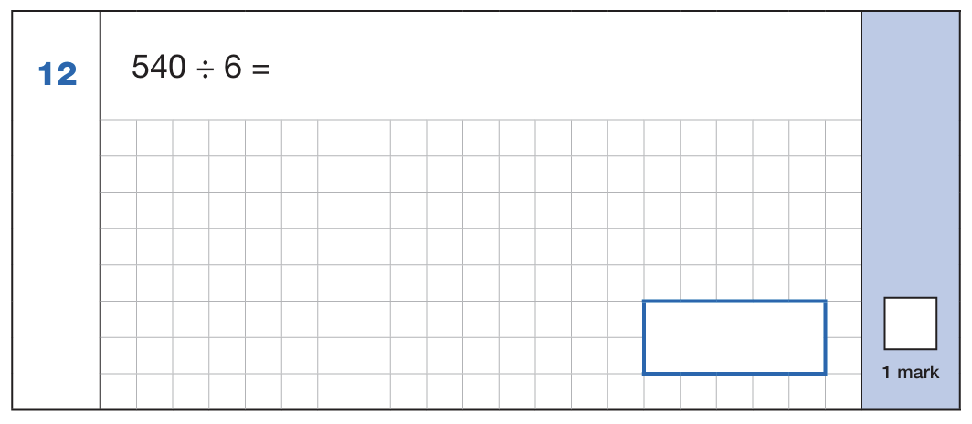

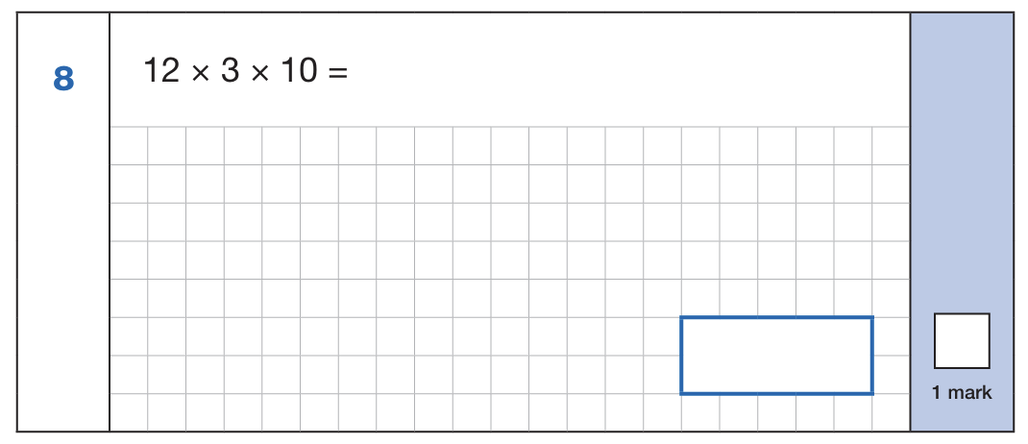
Maths Paper 1 (Arithmetic)
Example 1 mark questions:
Using known fact of 10% of 860 = 86
And 5% is half of 10%
86 ÷ 2 = 43
43
Known facts: 54 ÷ 6 = 9
90
Mental method:
Using known fact of 64 ÷ 8 = 8
80
⅝ x ⅓
5 x 1 = 5
8 x 3 = 24
⅝ x ⅓ = 5/24
5/24
12 x 3 = 39
39 x 10 = 390
390
Notes:
Questions are from the 2025 Arithmetic SATs paper.
These are examples of how children could solve the calculations. There are some that could/ should be solved mentally as it is far quicker that way (40 marks in 30 minutes does not allow for 1 minute + per mark).
Answers should always be given in their simplest form unless stated otherwise.
Note that for question 26, equivalent fractions or the exact decimal are accepted.

Slide 19


Maths Paper 1 (Arithmetic)
Example 2 mark question:
Notes:
Questions are from the 2025 Arithmetic SATs paper.

Slide 20
Maths Papers 2 and 3 (Reasoning)
Paper 2 will take place on Wednesday 13th May and paper 3 will take place on Thursday 14th May. These tests have a total of 35 marks each and lasts for 40 minutes each.
These papers require children to demonstrate their mathematical knowledge and skills, as well as their ability to solve problems and their mathematical reasoning. They cover a wide range of mathematical topics from key stage 2 including,
Number and place value (including Roman numerals);
The four operations;
Geometry (properties of shape, position and direction);
Statistics;
Measurement (length, perimeter, mass, volume, time, money);
Algebra;
Ratio and proportion;
Fractions, decimals and percentages.
Notes:
In general, the questions get progressively harder throughout the paper. As this is the case, it is not unusual for children to be unable to complete the entire paper in the given time.

Slide 21


Maths Paper 2 (Reasoning)
Example questions:
✔
✔
5
19
✔
7
17
11
13
Notes:
Questions are from the 2025 paper 2 Reasoning SATs paper.

Slide 22


Maths Paper 2 (Reasoning)
Example questions:
Notes:
Questions are from the 2025 paper 2 Reasoning SATs paper.

Slide 23
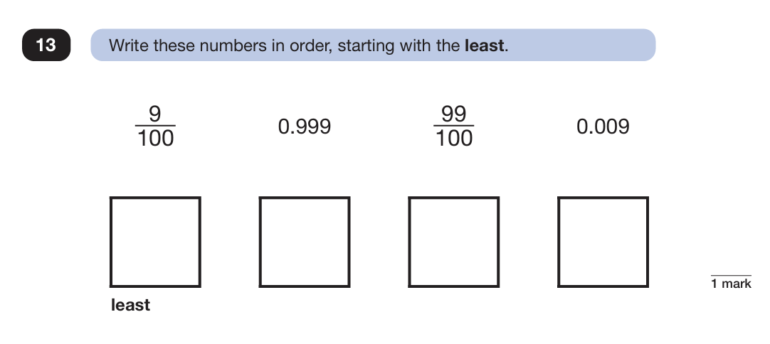
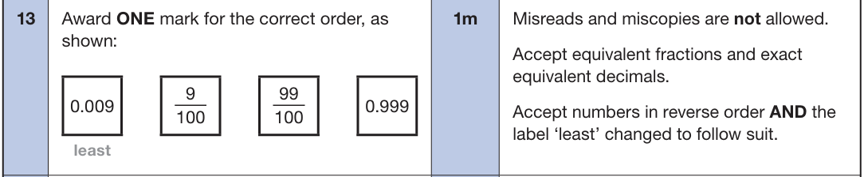
Maths Paper 3 (Reasoning)
Example questions:
Notes:
Questions are from the 2025 paper 3 Reasoning SATs paper.

Slide 24


Maths Paper 3 (Reasoning)
Example question:
Notes:
Questions are from the 2025 paper 3 Reasoning SATs paper.
Note that this is a three mark question.

Slide 25
Other Assessments
There is no writing SATS test.
Writing assessments will be formed from judgements made by the teacher, looking at evidence from writing collected over the course of the year.
The teacher will moderate their assessments with other professionals to make sure there is a consistent standard across the country.
Final judgements will be reported to parents at the same time as the other assessment results.
Science is also assessed from the children’s work. It is graded met or not met.

Slide 26
How can I help my child?
Help children not to feel worried or pressured about SATS. All that is asked is that they try their best, but please reassure children that the SATS should not be causing anxiety. Do give lots of praise and encouragement!
Help children with organising their homework (including spellings and mental arithmetic) and support their reading for pleasure activities.
Help them to have early nights and a healthy diet.
Help your child to have the best possible attendance at school.
Please speak to a member of staff if you have any questions or concerns.

Slide 27


