Slide 1
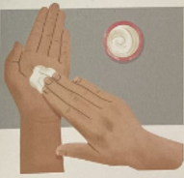

al
balm on your hand

Slide 2
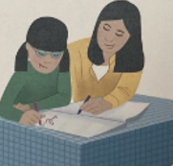
augh
she taught her daughter

Slide 3
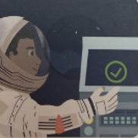
ss
permission for the mission

Slide 4
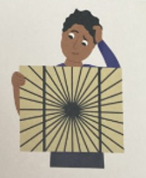
si
the illusion caused confusion

Slide 5
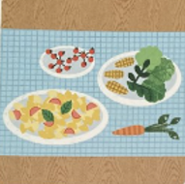
ti
scrumptious and nutritious

Slide 6
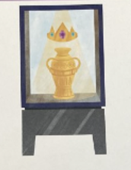
ci
a special and precious relic

