Slide 1
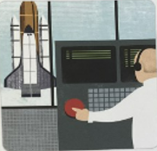

au
pause the launch

Slide 2
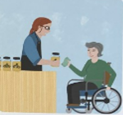
ey
use money to buy honey

Slide 3

a_e
cake by the lake

Slide 4
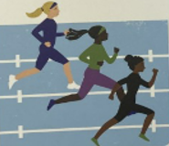
e_e
the athletes compete

