Slide 1
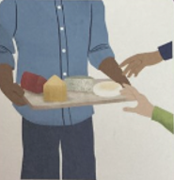

se
pass the cheese please

Slide 2
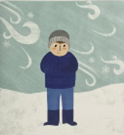
ze
freeze in the breeze

Slide 3
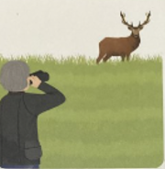
eer
peer at the deer

Slide 4
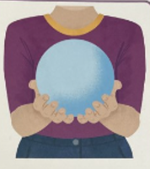
ere
here is the sphere

Slide 5
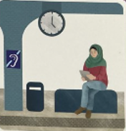
ti
waiting patiently at the station

