Slide 1


a
apricot on your apron

Slide 2

ey
they chose grey paint

Slide 3
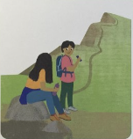
ea
a great break

Slide 4
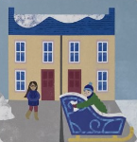
eigh
my neighbour has a sleigh

Slide 5
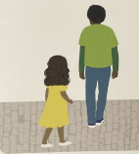
a
follow after my father

Slide 6
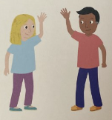
e
she waved to me

Slide 7
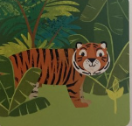
i
tiger in the wild

Slide 8
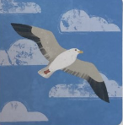
y
fly in the sky

