Slide 1


ay
play all day

Slide 2
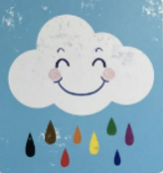
ou
a proud cloud

Slide 3
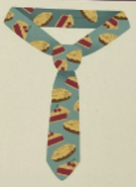
ie
pie on your tie

Slide 4
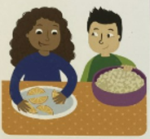
ea
each have a treat

