Slide 1
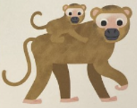

o
the monkey and his mother

