Slide 1
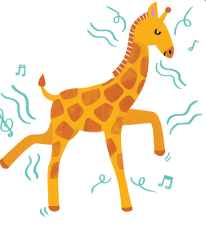

g
An energetic giraffe

Slide 2
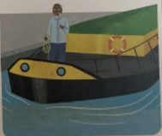
ge
take charge of the barge

Slide 3
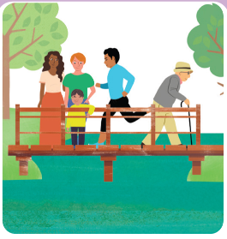
dge
Squidge on the bridge

Slide 4
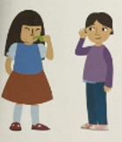
st
Listen to the whistle

